Slide 1
Expert System and Artificial Neural Network (ANN)

Slide 2
Expert System
An expert system consists of hardware and software that stores knowledge and makes inferences, enabling a novice to perform at the level of an expert.
Expert systems have many applications:
Business
Diagnosis
Industry
etc…
2

Slide 3
Characteristics and Limitations of an Expert System
Can explain its reasoning or suggested decisions
Can display “intelligent” behavior
Can draw conclusions from complex relationships
Can provide portable knowledge
Can deal with uncertainty

Slide 4
Limitations of an Expert System…
Not widely used or tested
Difficult to use
Limited to relatively narrow problems
Cannot readily deal with “mixed” knowledge
Possibility of error
Cannot refine its own knowledge
Difficult to maintain
May have high development costs
Expert system shell
A collection of software packages and tools used to develop expert systems
Raises legal and ethical concerns

Slide 5
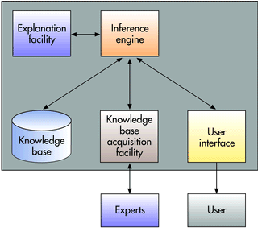
Components of an Expert System
5

Slide 6
Components of an Expert System…
An expert system consists of a collection of integrated and related components, including a knowledge base, an inference engine, an explanation facility, a knowledge base acquisition facility, and a user interface.
The user interacts with the interface, which interacts with the inference engine.
The inference engine interacts with the other expert system components.
These components must work together to provide expertise.
The inference engine coordinating the flow of knowledge to other components of the expert system.
6

Slide 7
Components of an Expert System…
Knowledge Base
Stores all relevant information, data, rules, cases, and relationships used by the expert system.
Uses
Rules
If-then Statements
Fuzzy Logic
7

Slide 8
Components of an Expert System…
Inference Engine
Seeks information and relationships from the knowledge base and provides answers, predictions, and suggestions the way a human expert would.
Uses
Backward Chaining
Forward Chaining
8

Slide 9
Components of an Expert System…
Seeks information and relationships from the knowledge base and provides answers, predictions, and suggestions the way a human expert would.
In other words, the inference engine is the component that delivers the expert advice.
Backward chaining
Starting with conclusions and working backward to the supporting facts
Forward chaining
Starting with the facts and working forwards to the conclusions
9

Slide 10
Components of an Expert System…
Explanation Facility
Allows a user to understand how the expert system arrived at certain conclusions or results.
For example: it allows a doctor to find out the logic or rationale of the diagnosis made by a medical expert system
10

Slide 11
Components of an Expert System…
Knowledge acquisition facility
Provide convenient and efficient means of capturing and storing all the components of the knowledge base.
Acts as an interface between experts and the knowledge base.
11

Slide 12
Components of an Expert System…
User Interface
Specialized user interface software employed for designing, creating, updating, and using expert systems.
The main purpose of the user interface is to make the development and use of an expert system easier for users and decision makers
12

Slide 13
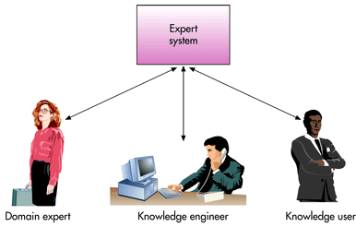
Participants in Developing and Using Expert Systems
13

Slide 14
Participants in Developing and Using Expert Systems…
Domain
The area of knowledge addressed by the expert system
Domain Expert
The individual or group who has the expertise or knowledge one is trying to capture in the expert system
Knowledge Engineer
An individual who has training or expertise in the design, development, implementation, and maintenance of an expert system
Knowledge User
The individual or group who uses and benefits from the expert system
14

Slide 15

Expert Systems Development
Steps in the expert system development process
15

Slide 16
What is ANN?
A neural network can be defined as a model of reasoning based on the human brain.
The brain consists of a densly interconnected set of nerve cells (information processing units) called neurons.
Human brain has 10 billion neurons and 60 trillion connections.
ANN’s are a type of artificial intelligence that attempts to imitate the way a human brain works.
The approach is beginning to prove useful in certain areas that involve recognizing complex patterns,
such as voice recognition and image recognition.

Slide 17
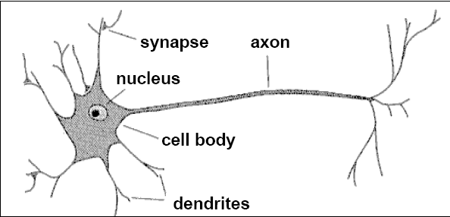
Biological Neuron
A neuron has a cell body, a branching input structure and a branching output structure (the axon)
Axons connect to dendrites via synapses.
Electro-chemical signals are propagated from the dendrites input, through the cell body, and down the axon to other neurons

Slide 18
Models of Neuron
Neuron is an information processing unit
A set of synapses or connecting links
–characterized by weight or strength
An adder
–summing the input signals weighted by synapses
–a linear combiner
An activation function
–also called squashing function
-squash (limits) the output to some finite values

Slide 19
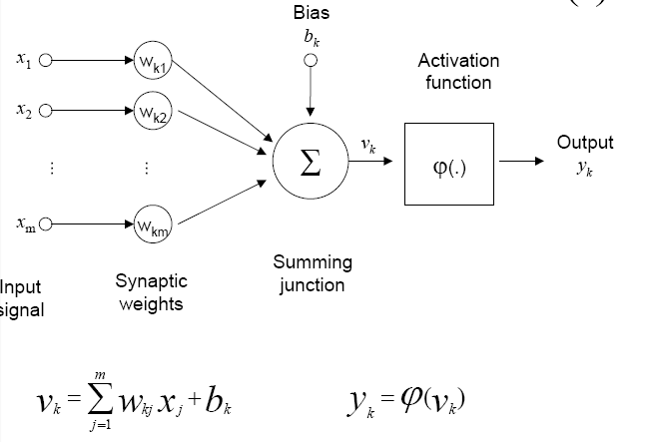
Model of Neuron

Slide 20
Requirements to Build an ANN
How many neurons are to be used?
How the neurons are to be connected to form a network.
Which learning algorithm to use?
How to train the neural network?
Training: Initialize the weights of the network and update the weights from a set of training examples

Slide 21
Diagram of a Neuron
Weight
Output Signals
Input signals
x₁
w₁
x₂
w₂
Neuron
Y
.
.
.
x₃
w_{n}

Slide 22
How Does the Neuron Determine its Output?
The neuron computes the weighted sum of the input signals and compares the result with a threshold value of, T_{h}
If the net weighted input is less than the threshold the neuron output is –1.
If the net weighted input is greater than or equal to the threshold, the neuron becomes activated and its output attains a value +1
(This type of activation function is called a sign function)

Slide 23
Example of NN: The Perceptron
Single neuron with adjustable synaptic weight and a hard limiter.
Hard Limiter
Linear Combiner
x1
w1
Y-output
Σ
w2
x2
Th
Threshold
Step & sign activation function called hard limit functions.

Slide 24
How Does the Perceptron Learn?
Step 1: Initialization
Set the initial weights w₁,w₂,….w_{n} and Threshold-Th
Step 2: Activation
Active the perceptron by applying inputs x₁(p), x₂(p)….. x_{n}(p) and desired output Y_{d}(p). Where p iteration, n number of inputs
Step 3: Weight Training
Update the weight of the perceptron.
Step 4: Iteration
Increase iteration p by one, go back to step 2 and repeat the process.

Slide 25
Train a Perceptron to Perform Logical AND operation (1)
Epoch | Inputs |  | Y(d) | Initial Weight |  | Output Y | Error e | Final Weight
 | x1 | x2 | Yd | w1 | w2 |  |  | w1 | w2
1 | 0 | 0 | 0 | 0.3 | -0.1 | 0 | 0 | 0.3 | -0.1
 | 0 | 1 | 0 | 0.3 | -0.1 | 0 | 0 | 0.3 | -0.1
 | 1 | 0 | 0 | 0.3 | -0.1 | 1 | -1 | 0.2 | -0.1
 | 1 | 1 | 1 | 0.2 | -0.1 | 0 | 1 | 0.3 | 0.0
2 | 0 | 0 | 0 | 0.3 | 0.0 | 0 | 0 | 0.3 | 0.0
 | 0 | 1 | 0 | 0.3 | 0.0 | 0 | 0 | 0.3 | 0.0
 | 1 | 0 | 0 | 0.3 | 0.0 | 1 | -1 | 0.2 | 0.0
 | 1 | 1 | 1 | 0.2 | 0.0 | 1 | 0 | 0.2 | 0.0
Threshold=0.2, Learning rate = 0.1

Slide 26
Train a Perceptron to Perform Logical AND operation (2)
Epoch | Inputs |  | Y(d) | Initial Weight |  | Output Y | Error | Final Weight
 | x1 | x2 | Yd | w1 | w2 |  |  | w1 | w2
3 | 0 | 0 | 0 | 0.2 | 0.0 | 0 | 0 | 0.2 | 0.0
 | 0 | 1 | 0 | 0.2 | 0.0 | 0 | 0 | 0.2 | 0.0
 | 1 | 0 | 0 | 0.2 | 0.0 | 1 | -1 | 0.1 | 0.0
 | 1 | 1 | 1 | 0.1 | 0.0 | 0 | 1 | 0.2 | 0.1
4 | 0 | 0 | 0 | 0.2 | 0.1 | 0 | 0 | 0.2 | 0.1
 | 0 | 1 | 0 | 0.2 | 0.1 | 0 | 0 | 0.2 | 0.1
 | 1 | 0 | 0 | 0.2 | 0.1 | 1 | -1 | 0.1 | 0.1
 | 1 | 1 | 1 | 0.1 | 0.1 | 1 | 0 | 0.1 | 0.1
Threshold=0.2, Learning rate = 0.1

Slide 27
Train a Perceptron to Perform Logical AND operation (3)
Epoch | Inputs |  | Y(d) | Initial Weight |  | Output Y | Error | Final Weight
 | x1 | x2 | Yd | w1 | W2 |  |  | w1 | w2
5 | 0 | 0 | 0 | 0.1 | 0.1 | 0 | 0 | 0.1 | 0.1
 | 0 | 1 | 0 | 0.1 | 0.1 | 0 | 0 | 0.1 | 0.1
 | 1 | 0 | 0 | 0.1 | 0.1 | 0 | 0 | 0.1 | 0.1
 | 1 | 1 | 1 | 0.1 | 0.1 | 1 | 0 | 0.1 | 0.1
Threshold=0.2, Learning rate = 0.1

Slide 28
Transfer Learning
“You need a lot of a data if you want to train/use CNNs”
Notes:
~ 10 - 15 minutes

Slide 29
Transfer Learning
“You need a lot of a data if you want to train/use CNNs”

Slide 30
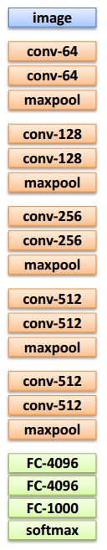
Transfer Learning with CNNs
1. Train on
Imagenet

Slide 31
Transfer Learning with CNNs
1. Train on
Imagenet
2. Small dataset:
feature extractor
Freeze these
Train this

Slide 32
Transfer Learning with CNNs
2. Small dataset:
feature extractor
3. Medium dataset:
finetuning
more data = retrain more of the network (or all of it)
1. Train on
Imagenet
Freeze these
Freeze these
Train this
Train this

Slide 33
Transfer Learning with CNNs
2. Small dataset:
feature extractor
3. Medium dataset:
finetuning
more data = retrain more of the network (or all of it)
1. Train on
Imagenet
Freeze these
Freeze these
tip: use only ~1/10th of the original learning rate in finetuning top layer, and ~1/100th on intermediate layers
Train this
Train this

Slide 34
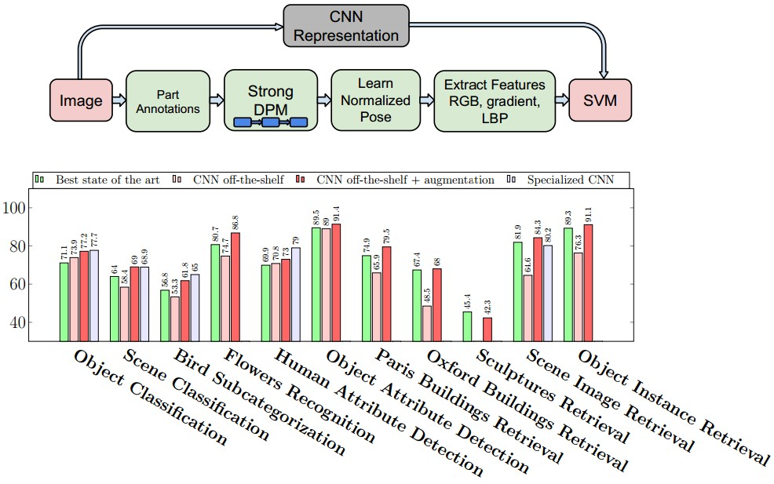
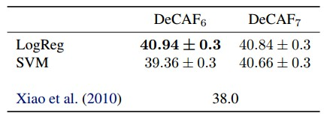
CNN Features off-the-shelf: an Astounding Baseline for Recognition
[Razavian et al, 2014]
DeCAF: A Deep Convolutional Activation Feature for Generic Visual Recognition
[Donahue*, Jia*, et al., 2013]
Notes:
Need to reread the papers

Slide 35
 | very similar dataset | very different dataset
very little data | ? | ?
quite a lot of data | ? | ?
more generic
more specific

Slide 36
 | very similar dataset | very different dataset
very little data | Use Linear Classifier on top layer | ?
quite a lot of data | Finetune a few layers | ?
more generic
more specific

Slide 37
 | very similar dataset | very different dataset
very little data | Use Linear Classifier on top layer | You’re in trouble… Try linear classifier from different stages
quite a lot of data | Finetune a few layers | Finetune a larger number of layers
more generic
more specific

Slide 38
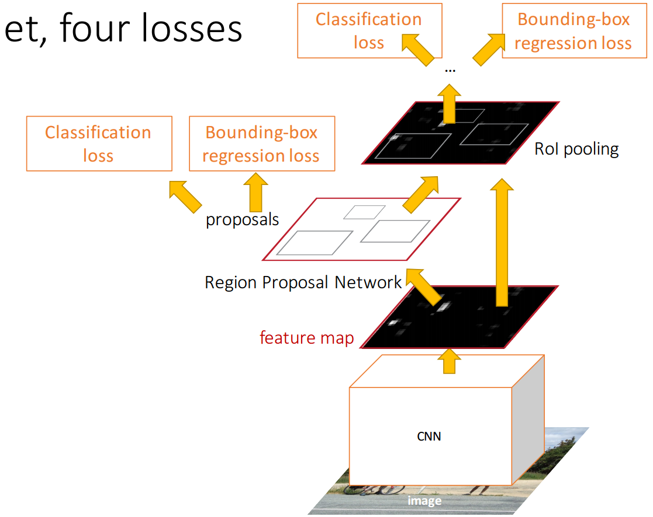
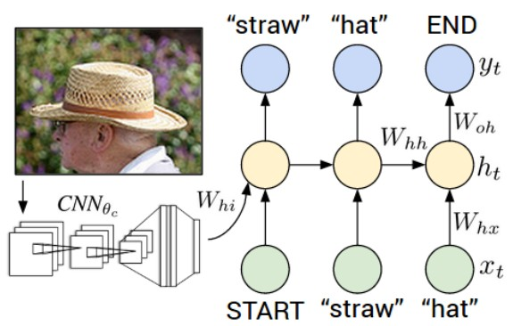
Transfer learning with CNNs is pervasive…
(it’s the norm, not an exception)
Image Captioning: CNN+RNN
Object Detection (Faster R-CNN)

Slide 39
Transfer learning with CNNs is pervasive…
(it’s the norm, not an exception)
Image Captioning: CNN+RNN
CNN pretrained on ImageNet
Object Detection (Faster R-CNN)

Slide 40
Transfer learning with CNNs is pervasive…
(it’s the norm, not an exception)
Image Captioning: CNN+RNN
CNN pretrained on ImageNet
Object Detection (Faster R-CNN)
Word vectors pretrained from word2vec

Slide 41
Takeaway for your projects/beyond:
Have some dataset of interest but it has < ~1M images?
Find a very large dataset that has similar data, train a big ConvNet there.
Transfer learn to your dataset
Caffe ConvNet library has a “Model Zoo” of pretrained models:
https://github.com/BVLC/caffe/wiki/Model-Zoo

Slide 42





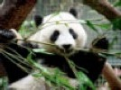
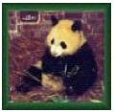
A Images
A Labels
Train using Caffe framework (Jia et al.)
500 Classes

Slide 43
A Images
A Labels
Train using Caffe framework (Jia et al.)
500 Classes
Notes:
train using the Caffe

Slide 44
A Images
A Labels
Train using Caffe framework (Jia et al.)
500 Classes

Slide 45
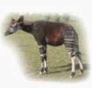
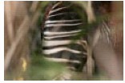
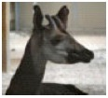

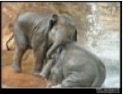
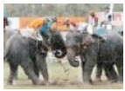
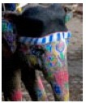
baseA
A Images
baseB
B Images

Slide 46
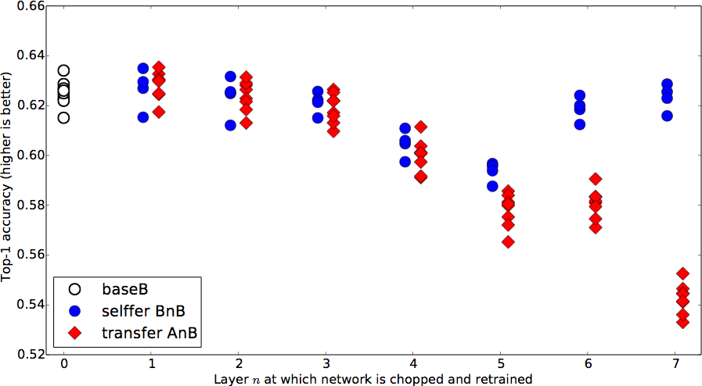
Notes:
Each point is average accuracy over validation set. Variants because of different 500 classes.

Slide 47
A Images
A Labels

Slide 48
B Images
B Labels
Hypothesis: if transferred features are specific to task A, performance drops. Otherwise the performance should be the same.

Slide 49

transfer
AnB
Compare to
B Images
B Labels
baseB

Slide 50
Notes:
FIRST layers generic for this A / B combination
OVERALL drop by the end is not large! (MANY RELATED CATEGORIES)
CURIOUS BUMP IN MIDDLE

Slide 51
B Images
B Labels

Slide 52
B Images
B Labels

Slide 53
selffer
BnB
B Images
B Labels

Slide 54
Notes:
When you chop half of the network, randomly initialize the rest of the network, keep the weights frozen, u have optimization issues. A so

Slide 55
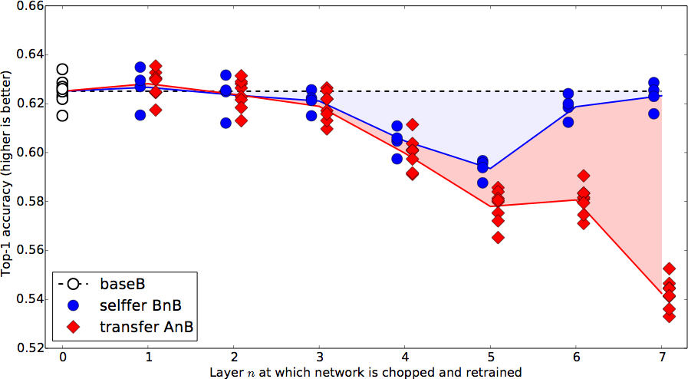

Slide 56
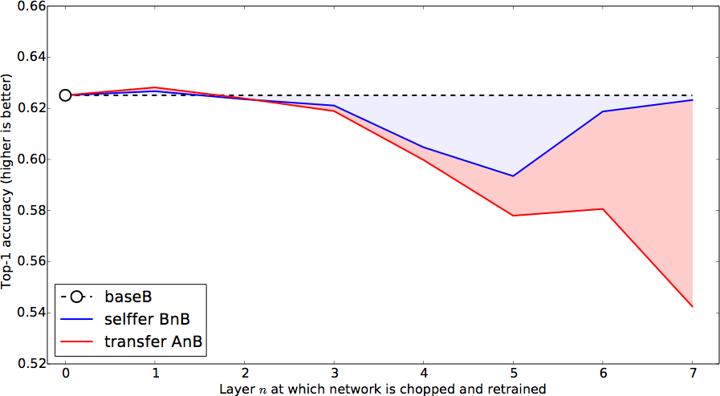
Performance drops due to...
Fragile
co-adaptation
Representation
specificity
Notes:
Not previously shown

Slide 57
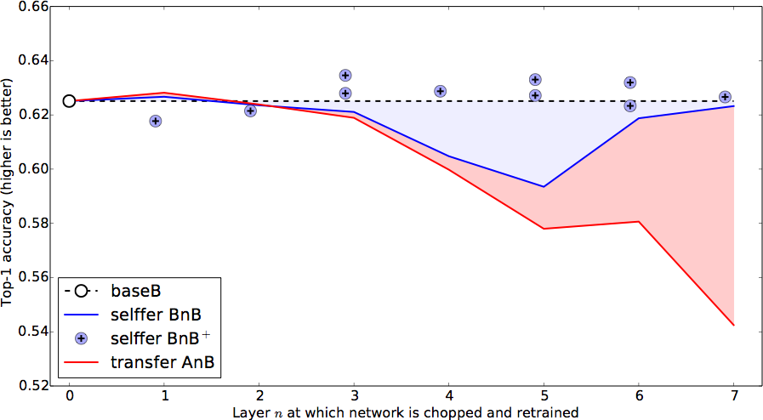
Notes:
Not previously shown

Slide 58
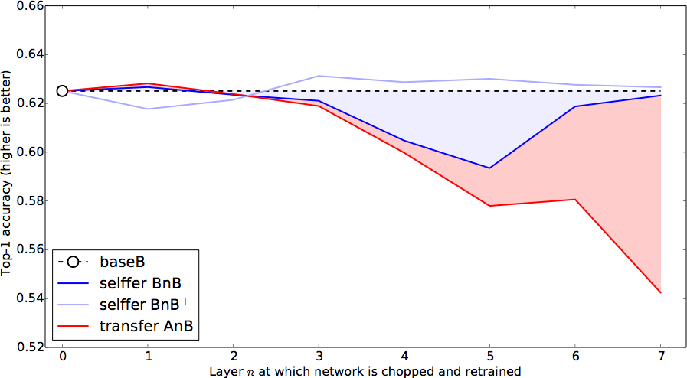
Notes:
Not previously shown

Slide 59
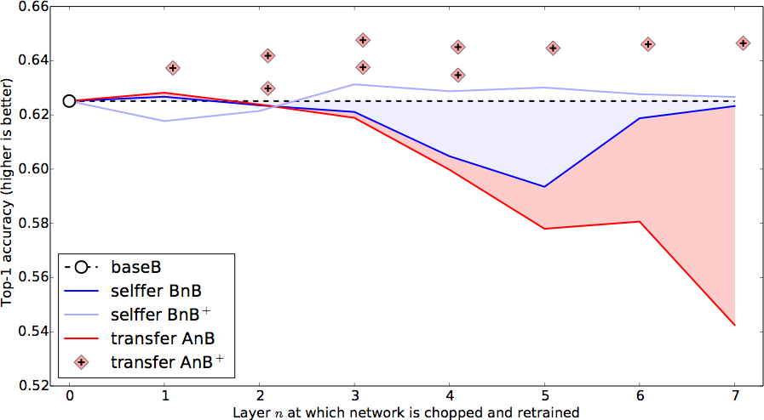
Notes:
Not previously shown

Slide 60
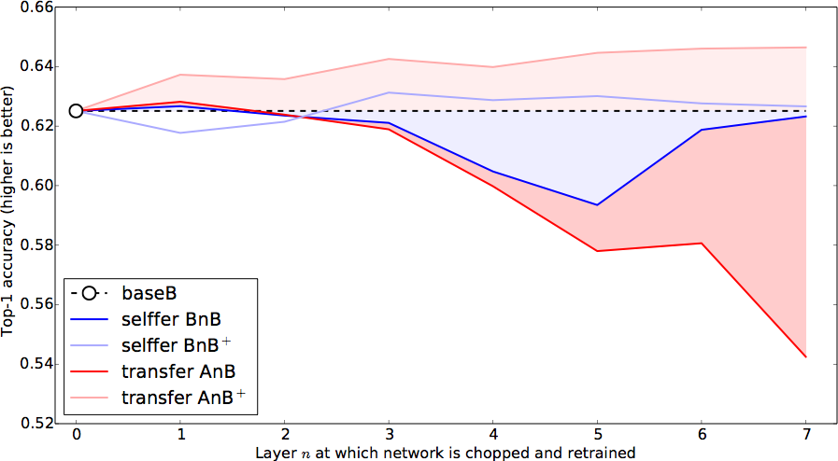
Notes:
Not previously shown

Slide 61
ImageNet has many related categories...
Dataset A: random
Dataset B: random
gecko
garbage truck
toucan
fire truck
radiator
binoculars
baseball
lion
panther
bookshop
rabbit
gorilla

Slide 62
ImageNet has many related categories...
Dataset A: man-made
Dataset B: natural
garbage truck
gorilla
fire truck
gecko
radiator
toucan
baseball
rabbit
binoculars
panther
bookshop
lion

Slide 63
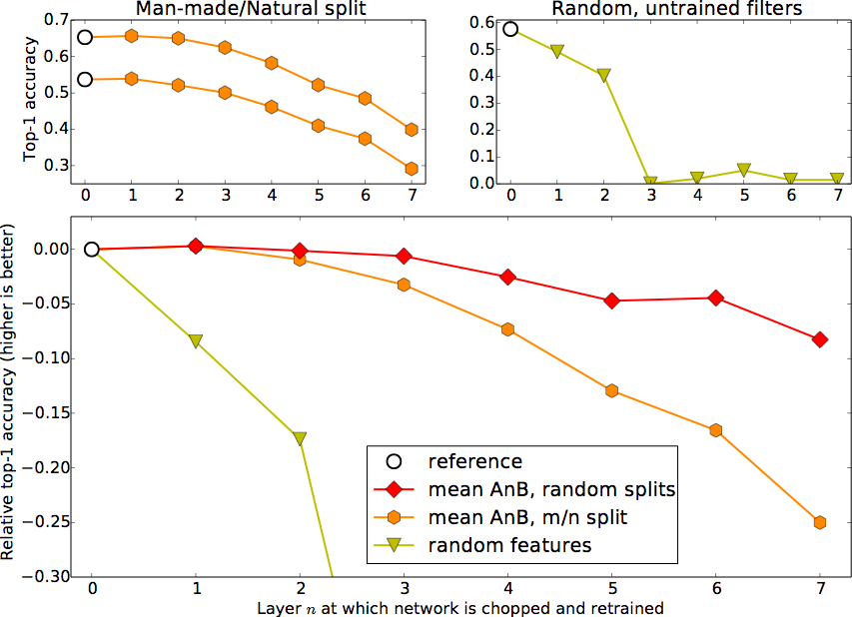
Similar A/B

Slide 64
Similar A/B
Dissimilar A/B

Slide 65
Similar A/B
Random
(Jarret et al. 2009)
Dissimilar A/B

Slide 66
All About Convolutions
Notes:
Should be ~25 minutes in by this point

Slide 67
All About Convolutions Part I: How to stack them

Slide 68
The power of small filters
Suppose we stack two 3x3 conv layers (stride 1)
Each neuron sees 3x3 region of previous activation map
Input
First Conv
Second Conv

Slide 69
The power of small filters
Question: How big of a region in the input does a neuron on the second conv layer see?
Input
First Conv
Second Conv

Slide 70
The power of small filters
Question: How big of a region in the input does a neuron on the second conv layer see?
Answer: 5 x 5
Input
First Conv
Second Conv

Slide 71
The power of small filters
Question: If we stack three 3x3 conv layers, how big of an input region does a neuron in the third layer see?

Slide 72
The power of small filters
Question: If we stack three 3x3 conv layers, how big of an input region does a neuron in the third layer see?
 |  |  |  |  | X
 |  |  |  | X
Answer: 7 x 7

Slide 73
The power of small filters
Question: If we stack three 3x3 conv layers, how big of an input region does a neuron in the third layer see?
 |  |  |  |  | X
 |  |  |  | X
Three 3 x 3 conv gives similar
representational
power as a single 7 x 7 convolution
Answer: 7 x 7

Slide 74
The power of small filters
Suppose input is H x W x C and we use convolutions with C filters to preserve depth (stride 1, padding to preserve H, W)

Slide 75
The power of small filters
Suppose input is H x W x C and we use convolutions with C filters to preserve depth (stride 1, padding to preserve H, W)
one CONV with 7 x 7 filters
Number of weights:
three CONV with 3 x 3 filters
Number of weights:

Slide 76
The power of small filters
Suppose input is H x W x C and we use convolutions with C filters to preserve depth (stride 1, padding to preserve H, W)
one CONV with 7 x 7 filters
Number of weights:
= C x (7 x 7 x C) = 49 C²
three CONV with 3 x 3 filters
Number of weights:
= 3 x C x (3 x 3 x C) = 27 C²

Slide 77
The power of small filters
Suppose input is H x W x C and we use convolutions with C filters to preserve depth (stride 1, padding to preserve H, W)
one CONV with 7 x 7 filters
Number of weights:
= C x (7 x 7 x C) = 49 C²
three CONV with 3 x 3 filters
Number of weights:
= 3 x C x (3 x 3 x C) = 27 C²
Fewer parameters, more nonlinearity = GOOD

Slide 78
The power of small filters
Suppose input is H x W x C and we use convolutions with C filters to preserve depth (stride 1, padding to preserve H, W)
one CONV with 7 x 7 filters
Number of weights:
= C x (7 x 7 x C) = 49 C²
Number of multiply-adds:
three CONV with 3 x 3 filters
Number of weights:
= 3 x C x (3 x 3 x C) = 27 C²
Number of multiply-adds:

Slide 79
The power of small filters
Suppose input is H x W x C and we use convolutions with C filters to preserve depth (stride 1, padding to preserve H, W)
one CONV with 7 x 7 filters
Number of weights:
= C x (7 x 7 x C) = 49 C²
Number of multiply-adds:
= (H x W x C) x (7 x 7 x C)
= 49 HWC²
three CONV with 3 x 3 filters
Number of weights:
= 3 x C x (3 x 3 x C) = 27 C²
Number of multiply-adds:
= 3 x (H x W x C) x (3 x 3 x C)
= 27 HWC²

Slide 80
The power of small filters
Suppose input is H x W x C and we use convolutions with C filters to preserve depth (stride 1, padding to preserve H, W)
one CONV with 7 x 7 filters
Number of weights:
= C x (7 x 7 x C) = 49 C²
Number of multiply-adds:
= 49 HWC²
three CONV with 3 x 3 filters
Number of weights:
= 3 x C x (3 x 3 x C) = 27 C²
Number of multiply-adds:
= 27 HWC²
Less compute, more nonlinearity = GOOD

Slide 81
The power of small filters
Why stop at 3 x 3 filters? Why not try 1 x 1?

Slide 82
The power of small filters
Why stop at 3 x 3 filters? Why not try 1 x 1?
“bottleneck” 1 x 1 conv to reduce dimension
H x W x C
Conv 1x1, C/2 filters
H x W x (C / 2)

Slide 83
The power of small filters
Why stop at 3 x 3 filters? Why not try 1 x 1?
“bottleneck” 1 x 1 conv to reduce dimension
3 x 3 conv at reduced dimension
H x W x C
Conv 1x1, C/2 filters
H x W x (C / 2)
Conv 3x3, C/2 filters
H x W x (C / 2)

Slide 84
The power of small filters
Why stop at 3 x 3 filters? Why not try 1 x 1?
“bottleneck” 1 x 1 conv to reduce dimension
3 x 3 conv at reduced dimension
Restore dimension with another 1 x 1 conv
[Seen in Lin et al, “Network in Network”, GoogLeNet, ResNet]
H x W x C
Conv 1x1, C/2 filters
H x W x (C / 2)
Conv 3x3, C/2 filters
H x W x (C / 2)
Conv 1x1, C filters
H x W x C

Slide 85
The power of small filters
Why stop at 3 x 3 filters? Why not try 1 x 1?
H x W x C
Conv 1x1, C/2 filters
Bottleneck sandwich
H x W x C
H x W x (C / 2)
Conv 3x3, C/2 filters
Conv 3x3, C filters
H x W x (C / 2)
Single 3 x 3 conv
H x W x C
Conv 1x1, C filters
H x W x C

Slide 86
The power of small filters
Why stop at 3 x 3 filters? Why not try 1 x 1?
More nonlinearity, fewer params, less compute!
H x W x C
Conv 1x1, C/2 filters
3.25 C² parameters
H x W x C
H x W x (C / 2)
Conv 3x3, C/2 filters
Conv 3x3, C filters
H x W x (C / 2)
9 C² parameters
H x W x C
Conv 1x1, C filters
H x W x C

Slide 87
CPU vs GPU Memory Hierarchy
CPU
GPU
6 MB register file (!)
5kB registers:
6 TB/s
60 TB/s
1.5 MB Constant Mem
20 TB/s
1 MB L1 Cache
4 TB/s
1.5 MB Shared Mem
1.5 TB/s
4 MB L2 Cache
20 MB L3 Cache
3 MB L2 Cache
500 GB/s
500 GB/s
10s GB Main Memory
12 GB Main Memory
40 GB/s
350 GB/s

Slide 88
CPU vs GPU Memory Hierarchy
CPU
GPU
6 MB register file (!)
5kB registers:
6 TB/s
60 TB/s
1.5 MB Constant Mem
20 TB/s
1 MB L1 Cache
4 TB/s
1.5 MB Shared Mem
1.5 TB/s
4 MB L2 Cache
20 MB L3 Cache
3 MB L2 Cache
500 GB/s
500 GB/s
10s GB Main Memory
12 GB Main Memory
40 GB/s
350 GB/s

Slide 89
Thank you

